Slide 1
Introduction
A sequential circuit consists of a feedback path, and employs some memory elements.
Combinational outputs
Memory outputs
Combinational logic
Memory elements
External inputs
Sequential circuit = Combinational logic + Memory Elements

Slide 2
Introduction
There are two types of sequential circuits:
  synchronous: outputs change only at specific time
  asynchronous: outputs change at any time
Multivibrator: a class of sequential circuits. They can be:
  bistable (2 stable states)
  monostable or one-shot (1 stable state)
  astable (no stable state)
Bistable logic devices: latches and flip-flops.
Latches and flip-flops differ in the method used for changing their state.

Slide 3
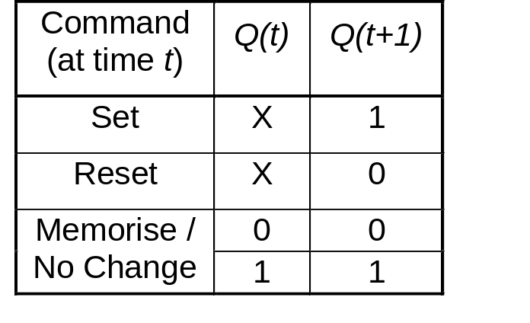
Memory Elements
Memory element: a device which can remember value indefinitely, or change value on command from its inputs.
Characteristic table:
Memory element
Q
command
stored value
Q(t): current state
Q(t+1) or Q⁺: next state

Slide 4
Memory Elements
Memory element with clock. Flip-flops are memory elements that change state on clock signals.
Clock is usually a square wave.
Memory element
Q
command
stored value
clock
Positive pulses
Positive edges
Negative edges

Slide 5
Memory Elements
Two types of triggering/activation:
  pulse-triggered
  edge-triggered
Pulse-triggered
  latches
  ON = 1, OFF = 0
Edge-triggered
  flip-flops
  positive edge-triggered (ON = from 0 to 1; OFF = other time)
  negative edge-triggered (ON = from 1 to 0; OFF = other time)

Slide 6
S-R Latch
Complementary outputs: Q and Q'.
When Q is HIGH, the latch is in SET state.
When Q is LOW, the latch is in RESET state.
For active-HIGH input S-R latch (also known as NOR gate latch),
R=HIGH (and S=LOW)  RESET state
S=HIGH (and R=LOW)  SET state
both inputs LOW  no change
both inputs HIGH  Q and Q' both LOW (invalid)!

Slide 7
S-R Latch
For active-LOW input S'-R' latch (also known as NAND gate latch),
R'=LOW (and S'=HIGH)  RESET state
S'=LOW (and R'=HIGH)  SET state
both inputs HIGH  no change
both inputs LOW  Q and Q' both HIGH (invalid)!
Drawback of S-R latch: invalid condition exists and must be avoided.

Slide 8
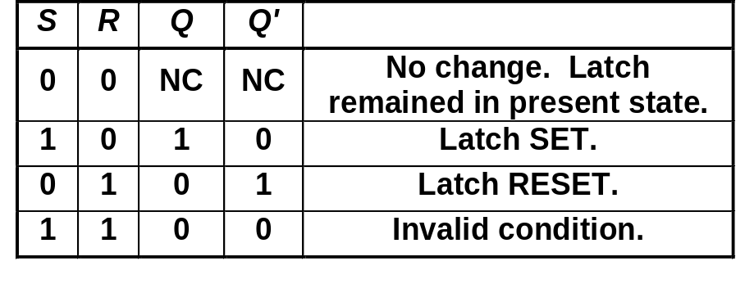
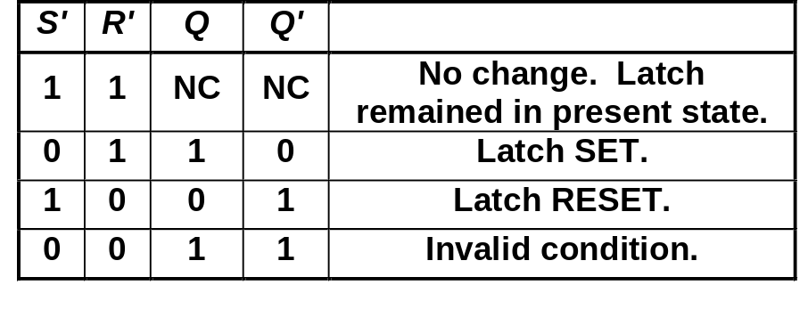
S-R Latch
Characteristics table for active-high input S-R latch:
Characteristics table for active-low input S'-R' latch:
S
R
Q
Q'
S
R
Q
Q'

Slide 9
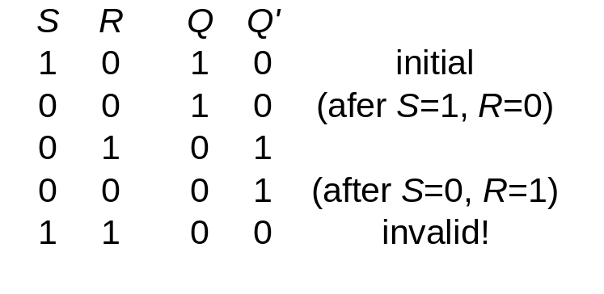
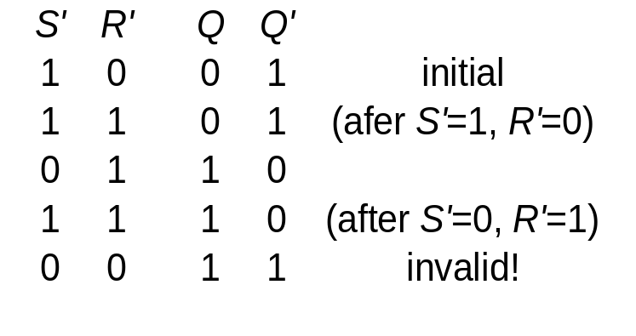
S-R Latch
Active-HIGH input S-R latch
Active-LOW input S’-R’ latch
1
0
1
0
0
R
1
1
0
0
Q
0
Q'
0
0
1
1
1
0
0
0
0
1
S
S'
Q
R'
Q'
S'
Q
R'
Q'

Slide 10
Gated S-R Latch
S-R latch + enable input (EN) and 2 NAND gates → gated S-R latch.
S
Q
S
EN
R
Q
Q'
EN
Q'
R

Slide 11
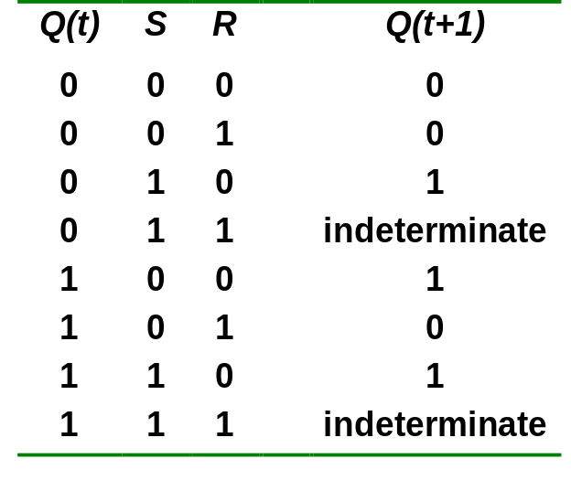
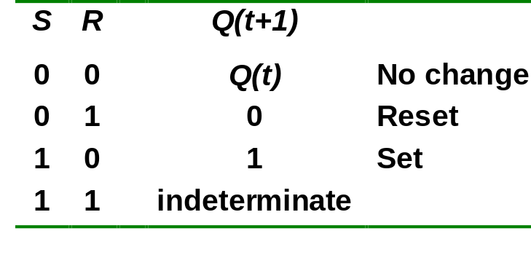
Gated S-R Latch
Outputs change (if necessary) only when EN is HIGH.
Under what condition does the invalid state occur?
Characteristic table:
EN=1
Q(t+1) = S + R'.Q
S.R = 0

Slide 12
Gated D Latch
Make R input equal to S' → gated D latch.
D latch eliminates the undesirable condition of invalid state in the S-R latch.
D
Q
D
EN
Q
Q'
EN
Q'

Slide 13
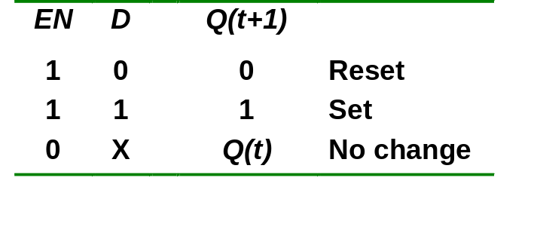
Gated D Latch
When EN is HIGH,
  D=HIGH → latch is SET
  D=LOW → latch is RESET
Hence when EN is HIGH, Q ‘follows’ the D (data) input.
Characteristic table:
When EN=1, Q(t+1) = D

Slide 14
Latch Circuits: Not Suitable
Latch circuits are not suitable in synchronous logic circuits.
When the enable signal is active, the excitation inputs are gated directly to the output Q. Thus, any change in the excitation input immediately causes a change in the latch output.
The problem is solved by using a special timing control signal called a clock to restrict the times at which the states of the memory elements may change.
This leads us to the edge-triggered memory elements called flip-flops.

Slide 15
Edge-Triggered Flip-flops
Flip-flops: synchronous bistable devices
Output changes state at a specified point on a triggering input called the clock.
Change state either at the positive edge (rising edge) or at the negative edge (falling edge) of the clock signal.
Clock signal
Positive edges
Negative edges

Slide 16
Edge-Triggered Flip-flops
S-R, D and J-K edge-triggered flip-flops. Note the “>” symbol at the clock input.
S
C
R
Q
Q'
D
C
Q
Q'
J
C
K
Q
Q'
Positive edge-triggered flip-flops
S
C
R
Q
Q'
D
C
Q
Q'
J
C
K
Q
Q'
Negative edge-triggered flip-flops

Slide 17
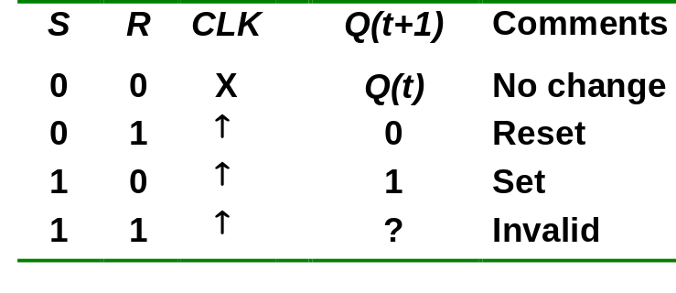
S-R Flip-flop
S-R flip-flop: on the triggering edge of the clock pulse,
  S=HIGH (and R=LOW)  SET state
  R=HIGH (and S=LOW)  RESET state
  both inputs LOW  no change
  both inputs HIGH  invalid
Characteristic table of positive edge-triggered S-R flip-flop:
X = irrelevant (“don’t care”)
↑ = clock transition LOW to HIGH

Slide 18
S-R Flip-flop
It comprises 3 parts:
  a basic NAND latch
  a pulse-steering circuit
  a pulse transition detector (or edge detector) circuit
The pulse transition detector detects a rising (or falling) edge and produces a very short-duration spike.

Slide 19
S-R Flip-flop
The pulse transition detector.
S
Q
Pulse transition detector
CLK
Q'
R
CLK'
CLK'
CLK
CLK*
CLK
CLK*
CLK
CLK
CLK'
CLK'
CLK*
CLK*
Positive-going transition
(rising edge)
Negative-going transition
(falling edge)

Slide 20
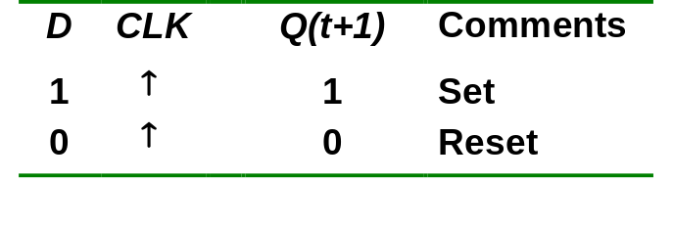
D Flip-flop
D flip-flop: single input D (data)
  D=HIGH  SET state
  D=LOW  RESET state
Q follows D at the clock edge.
Convert S-R flip-flop into a D flip-flop: add an inverter.
D
S
C
R
Q
Q'
CLK
↑ = clock transition LOW to HIGH
A positive edge-triggered D flip-flop formed with an S-R flip-flop.

Slide 21
D Flip-flop
Application: Parallel data transfer.
To transfer logic-circuit outputs X, Y, Z to flip-flops Q₁, Q₂ and Q₃ for storage.
D
CLK
Q
Q'
Q1 = X*
X
Combinational logic circuit
Y
D
CLK
Q
Q'
Q2 = Y*
Z
D
CLK
Q
Q'
Q3 = Z*
Transfer
* After occurrence of negative-going transition

Slide 22
J-K Flip-flop
J-K flip-flop: Q and Q' are fed back to the pulse-steering NAND gates.
No invalid state.
Include a toggle state.
  J=HIGH (and K=LOW)  SET state
  K=HIGH (and J=LOW)  RESET state
  both inputs LOW  no change
  both inputs HIGH  toggle

Slide 23
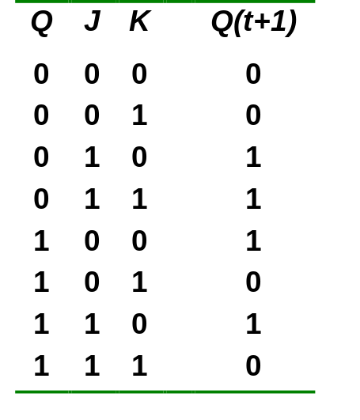
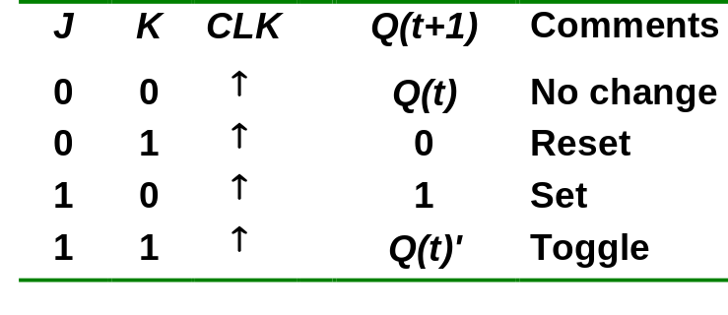
J-K Flip-flop
J-K flip-flop.
Characteristic table.
J
Q
Pulse transition detector
CLK
Q'
K
Q(t+1) = J.Q' + K'.Q

Slide 24
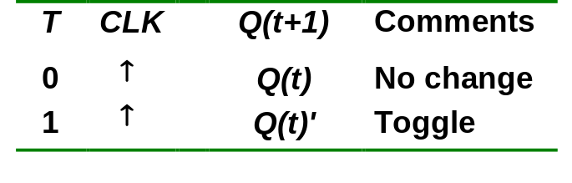
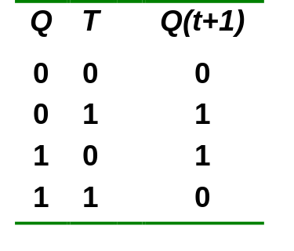
T Flip-flop
T flip-flop: single-input version of the J-K flip flop, formed by tying both inputs together.
Characteristic table.
T
T
Q
J
C
K
Q
Q'
Pulse transition detector
CLK
CLK
Q'
Q(t+1) = T.Q' + T'.Q

Slide 25
T Flip-flop
Application: Frequency division.
Application: Counter (to be covered in Lecture 13.)
High
High
High
J
C
K
Q
J
C
K
QA
J
C
K
QB
CLK
CLK
CLK
CLK
Q
QA
QB
Divide clock frequency by 2.
Divide clock frequency by 4.

Slide 26
Asynchronous Inputs
S-R, D and J-K inputs are synchronous inputs, as data on these inputs are transferred to the flip-flop’s output only on the triggered edge of the clock pulse.
Asynchronous inputs affect the state of the flip-flop independent of the clock; example: preset (PRE) and clear (CLR) [or direct set (SD) and direct reset (RD)]
When PRE=HIGH, Q is immediately set to HIGH.
When CLR=HIGH, Q is immediately cleared to LOW.
Flip-flop in normal operation mode when both PRE and CLR are LOW.

Slide 27
Asynchronous Inputs
A J-K flip-flop with active-LOW preset and clear inputs.
PRE
PRE
J
Q
J
C
K
Q
Q'
Pulse transition detector
CLK
K
Q'
CLR
CLR
CLK
PRE
CLR
J = K = HIGH
Q
Preset
Toggle
Clear

Slide 28
Asynchronous (Ripple) Counters
Example: 2-bit ripple binary counter.
Output of one flip-flop is connected to the clock input of the next more-significant flip-flop.
HIGH
J
Q₀
J
Q₁
CLK
C
Q₀
C
K
K
FF0
FF1
CLK
1
2
3
4
Q₀
Timing diagram
00 → 01 → 10 → 11 → 00 ...
Q₀
0
1
0
1
0
Q₁
0
0
1
1
0
Asynchronous (Ripple) Counters

Slide 29
Asynchronous (Ripple) Counters
Example: 3-bit ripple binary counter.
HIGH
J
Q₀
J
Q₁
J
Q₂
CLK
C
Q₀
C
Q₁
C
K
K
K
FF0
FF1
FF2
CLK
1
2
3
4
5
6
7
8
Q₀
0
1
0
1
0
1
0
1
0
Q₁
0
0
1
1
0
0
1
1
0
Q₂
0
0
0
0
1
1
1
1
0
Recycles back to 0
Asynchronous (Ripple) Counters

Slide 30
Asynchronous (Ripple) Counters
Example: 4-bit ripple binary counter (negative-edge triggered).
HIGH
J
Q₀
J
Q₁
J
Q₂
J
Q₃
CLK
C
C
C
C
K
K
K
K
FF0
FF1
FF2
FF3
CLK
1
2
3
4
5
6
7
8
9
10
11
12
13
14
15
16
Q₀
Q₁
Q₂
Q₃
Asynchronous (Ripple) Counters

Slide 31
Introduction: Registers
An n-bit register has a group of n flip-flops and some logic gates and is capable of storing n bits of information.
The flip-flops store the information while the gates control when and how new information is transferred into the register.
Some functions of register:
  retrieve data from register
  store/load new data into register (serial or parallel)
  shift the data within register (left or right)
Introduction: Registers

Slide 32
Simple Registers
No external gates.
Example: A 4-bit register. A new 4-bit data is loaded every clock cycle.
A₃
A₂
A₁
A₀
Q
Q
Q
Q
D
D
D
D
CP
I₃
I₂
I₁
I₀
Simple Registers

Slide 33
Serial In/Parallel Out Shift Registers
Accepts data serially.
Outputs of all stages are available simultaneously.
Data input
D
Q
D
Q
D
Q
D
Q
C
C
C
C
CLK
Q₀
Q₁
Q₂
Q₃
Data input
D
SRG 4
Logic symbol
CLK
C
Q₀
Q₁
Q₂
Q₃
Serial In/Parallel Out Shift Registers

Slide 34
Parallel In/Parallel Out Shift Registers
Simultaneous input and output of all data bits.
Parallel data inputs
D₀
D₁
D₂
D₃
D
Q
D
Q
D
Q
D
Q
C
C
C
C
CLK
Q₀
Q₁
Q₂
Q₃
Parallel data outputs
Parallel In/Parallel Out Shift Registers

